Slide 1
Predicting Loan Outcomes
Karthik Kaimal
09/05/2018
GA Final Project

Slide 2
Problem Statement
Predicting performance of loan portfolios is core to all financial/lending institutions. The goal of this exercise is to analyze historical loan behavior and apply data science techniques to predict charge-offs for current loans.
We will be looking at 10 years (2007-2017) of loan data made publicly available to us by Lending Club.
For the purposes of today’s exercise, we will not be getting into predicting whether or not a loan is likely to get approved by LC. All the modeling is for the phase after a loan is issued.

Slide 3
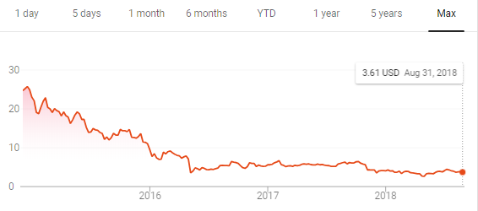
Background on Lending Club
Lending Club, founded in 2006, is a leading player in the peer-to-peer (P2P) lending space. Total loans issued through the platform eclipsed $35B in March, 2018.
In its category, LC was the first company to be publicly traded in the U.S. back in 2014. The market cap today is ~$1.6B.
Key Stats:
Market Cap: $1.6B
Current Price: $3.74
52 Wk. High (Low): $6.56 ($2.57)
Revenue: ~$700M (annual)
Net Income: ($190M)

Slide 4
How does LC make money?
LC collects fees from both borrowers and investors.
Investors pay a service fee of 1% of the amount of borrower payments received through LC. In the cases of loan recoveries, investors pay 18% of borrower payments!
Borrowers pay APRs ranging from 6% to 36%. LC receives a one time origination fee.
Loan amounts range from $1,000 to $40,000 and caters to loans for various purposes such as personal finance (debt consolidation, payment of credit cards, home improvement) and business loans.

Slide 5
Methodology
Data Gathering
Treatment of data to normalize attributes
Visual exploration
Determination of model type (regression vs. classification)
Model building
Application of model

Slide 6
Data Gathering Phase
Source of loan data: Kaggle (https://www.kaggle.com/wordsforthewise/lending-club)
Data Dictionary: Lending Club (https://www.lendingclub.com/info/download-data.action)
Loan stats:
1.6M rows X 150 columns
Completed loans (not current): ~647k Fully Paid and ~168k Charged Off
Example fields from data set –
Loan Amount, Annual Income of borrower, FICO at Loan Origination, Number of charge-offs in past 12 months, Debt-to-Income ratio, employment length, LC assigned loan grade, Interest Rate of the loan, Loan Status (Fully Paid vs. Charged Off), Revolving Utilization Rate, Loan Term (36 vs 60 months), Stated purpose for requesting the loan.

Slide 7
Treatment of Data
Convert date fields from ‘string’ to ‘dates’.
Assign numbers to Loan Status: 1for Fully Paid and 0 for Charged Off loans.
Convert Term Length from string to integer (36 or 60).
Assign integer values to Home Ownership type (0 for “Own”, 1 for “Mortgage”, 2 for “Rent”, etc.)
Convert Employment Length to integer
Treat Nan fields:
Deduce Revolving Utilization from Total Current Balance and Total Credit Limit.
Take medians/ means where applicable (revol_util).
Drop nan when sample size is tiny.

Slide 8
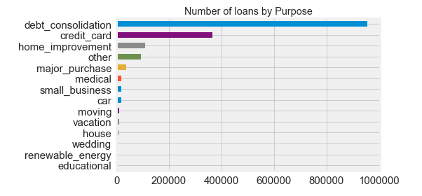
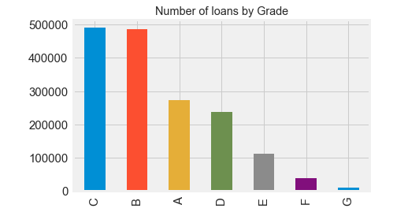
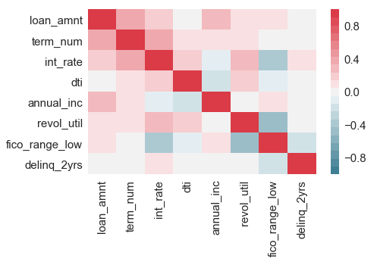
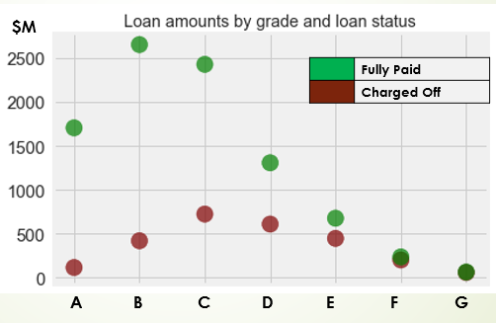
Data Exploration

Slide 9
Classification Problem
K Nearest Neighbors and Random Forest Classifier
Success Metric:
The purpose of the model is to predict “bad” loans. While Accuracy is a good indicator, minimizing False Positives (model predicts a loan will be paid but it actually doesn’t) is an important success metric.

Slide 10
KNN Model
Features Used: DTI, Loan Amount, Term, Interest Rate, Annual Income, FICO at origination, Revolving Utilization Rate, and Number of 30+ days past due delinquencies for 2 years.
Applied train_test_split and Standard Scaler
Optimized for K (92)
When K=5, Accuracy = 76.5%
When K=92, Accuracy = 79.5%
Confusion Matrix:
Model
2,939 | 39,087
2,694 | 159,018
Null Model: 42,026
Actual

Slide 11
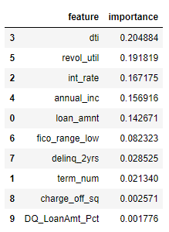
Random Forest Classifier
Features Used: DTI, Loan Amount, Term, Interest Rate, Annual Income, FICO at origination, Revolving Utilization Rate, and Number of 30+ days past due delinquencies for 2 years.
Added 2 new features – (Charged Off Within 12 months) ^ 2
(Delinquent Amount) *100/ (Loan Amount)
Applied train_test_split
Accuracy = 79%
Confusion Matrix:
Model
Actual
4,915 | 37,111
5,791 | 155,921
Null Model: 42,026

Slide 12
Areas for refinement
More feature engineering
Analyze “Rejected” loan data to come up with model to predict probability of a loan getting accepted
Try out other models:
Gradient Boosting
XGBoost
Logistic Regression
Other Ensembles

